Slide 1
Requirement Engineering Phases : (Case Study : Smart Parking System)
Ms. Shehla Saeed
Notes:
Introduction to the early phases of RE where analysts work to identify stakeholders and collect the right requirements for system success.

Slide 2
Lecture Overview
Requirements Engineering (RE)
Traditional RE phases
UML-based RE phases
Difference b/w the two approaches
Apply RE phases to a Smart Parking System

Slide 3
What is Requirement Engineering?
Requirements Engineering is the process of discovering, analyzing, documenting, validating, and managing system requirements.
Goal:
Ensure the software system meets stakeholder needs and solves the real problem.
Notes:
Requirement Engineering (RE) forms the foundation of all software projects. Each phase builds upon the previous one to ensure system correctness.

Slide 4
Traditional Requirements Engineering Phases
Traditional RE generally includes:
Requirements Elicitation
Requirements Analysis
Requirements Specification
Requirements Validation
Requirements Management
Mostly document-driven approach.

Slide 5
Traditional approach problems:
Heavy documentation(textual SRS)
Difficult stakeholder understanding
Limited visualization of system behavior
This led to the rise of model-based approaches using UML.

Slide 6
Difference b/w the 2 approaches
Traditional RE is like writing a detailed description of a city.
UML-based RE is like drawing the city map showing roads, buildings, and how people move between them.
Both describe the same city, but the second one lets people see the structure instantly.

Slide 7
UML-Based RE Phases
UML-based RE includes:
Inception
Elicitation
Elaboration
Negotiation
Specification
Validation
Requirements Management

Slide 8
Phase 1: Inception
Objectives:
Understand problem domain
Identify key stakeholders
Define project scope and goals
Activities:
Identify stakeholders
Define the system purpose
Understand the problem environment
Establish project feasibility
Notes:
Inception is the 'getting started' phase. The main purpose is to define what problem we are solving, who is involved, and whether it’s feasible to proceed.

Slide 9
Example: Smart Parking System (Inception)
Problem: Drivers cannot easily locate available parking spaces, traffic congestion.
Goal: Develop a system that provides real-time parking information through a mobile application.
Scope: The Smart Parking System will include:
Real-time parking space detection, Mobile application for drivers, Parking reservation system, Online payment system, Notifications and alerts, Parking management dashboard
Out of Scope: The system will NOT include:
Physical parking construction, Traffic signal management, Law enforcement automation.
Notes:
This example illustrates how inception helps define the vision and boundaries before development starts.
Scope defines what the system will do and what it will NOT do

Slide 10
Feasibility Assessment
Budget Feasibility (Economic Feasibility)
Time Feasibility (Schedule Feasibility)
Business Feasibility
Potential benefits
Possible Revenue sources
Technical Feasibility
whether the technology exists to implement the system.
Notes:
Budget feasibility determines whether the organization can afford to develop and maintain the system. It compares estimated project cost with available budget.
Time feasibility evaluates whether the system can be developed and implemented within the required time frame.
Potential Benefits
Reduced traffic congestion
Improved parking revenue
Efficient parking management
Better driver experience
Possible Revenue Sources
Parking fees
Reservation charges
Premium parking services
Advertising in mobile app
Required Technologies
Parking Sensors Detect vehicle presence.
Mobile Application Android / iOS interface for drivers.
Cloud Server Stores parking data.
GPS Integration Provides navigation.
Payment Gateway Supports digital transactions.

Slide 11
Stakeholder Identification
Primary Stakeholders
Stakeholder | Role
Drivers | Use mobile app to find parking
Parking Authority | Manage parking infrastructure
City Administration | Monitor traffic and parking utilization
Parking Attendants | Assist drivers and maintain parking areas
System Administrators | Maintain system operations
External Stakeholders
Stakeholder | Role
Payment Gateway Providers | Process digital payments
Mobile Network Providers | Provide internet connectivity
Hardware Vendors | Provide parking sensors and cameras

Slide 12
Initial System Features
During inception, only high-level features are identified.
Major System Features
Real-Time Parking Availability : Sensors detect whether parking spots are occupied.
Parking Search: Drivers can search nearby parking areas.
Parking Reservation: Drivers can reserve a spot before arrival.
Navigation Support: Drivers receive directions to the parking spot.
Online Payment: Digital payment via mobile app.
Parking Notifications: Alerts for reservation confirmation and parking expiration.
Admin Dashboard: Parking authorities can monitor occupancy and revenue.
Notes:
High level Use case diagrams

Slide 13
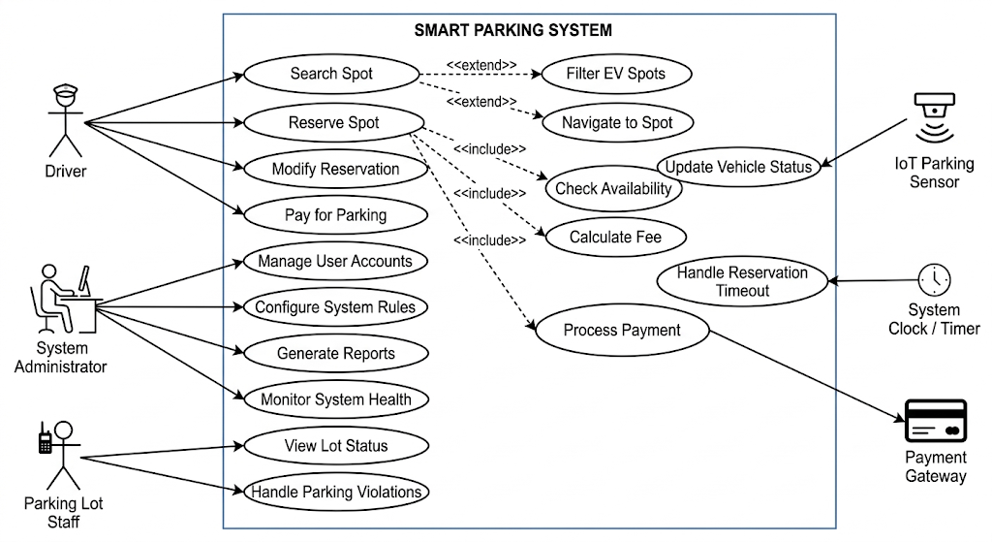

Slide 14
Risk Identification
Early risks are identified during inception.
Possible Risks
Sensor failure leading to incorrect parking data
Poor internet connectivity
User resistance to new technology
Security risks in online payment systems
Early risk identification allows teams to prepare mitigation strategies later.

Slide 15
Phase 2: Elicitation
Objective: Gather detailed requirements from stakeholders
Techniques:
Interviews
Questionnaires
Observation
Workshops
Prototyping
Use cases
.
Notes:
Elicitation focuses on communication. Analysts use multiple methods to ensure that real user needs are captured and understood.

Slide 16
Challenges in Elicitation
Stakeholders unsure of what they want
Conflicting needs
Communication barriers
Changing requirements
Notes:
Discuss how analysts overcome these issues using iterative meetings, prototypes, and good documentation practices.

Slide 17
Elicitation Results (Smart Parking)
Findings from stakeholder discussions:
Drivers need:
Real-time parking availability
Navigation to available parking
Online payment option
Parking authorities need:
Parking usage reports
Monitoring of parking occupancy
Revenue tracking
Notes:
Detailed Use case diagrams

Slide 18
Phase 3: Elaboration
Elaboration refines the collected requirements and develops detailed requirement models using UML.
Activities include:
Developing use case models
Identifying system actors
Defining system interactions
Understanding functional workflows
Goal
Transform raw requirements into structured system models.
Notes:
Activity Diagrams: map the step-by-step workflow of a driver booking a spot and navigating to it.
Conceptual Class Diagrams: build a domain dictionary. define that a Reservation class must be linked to a User class and a ParkingSpot clas

Slide 19
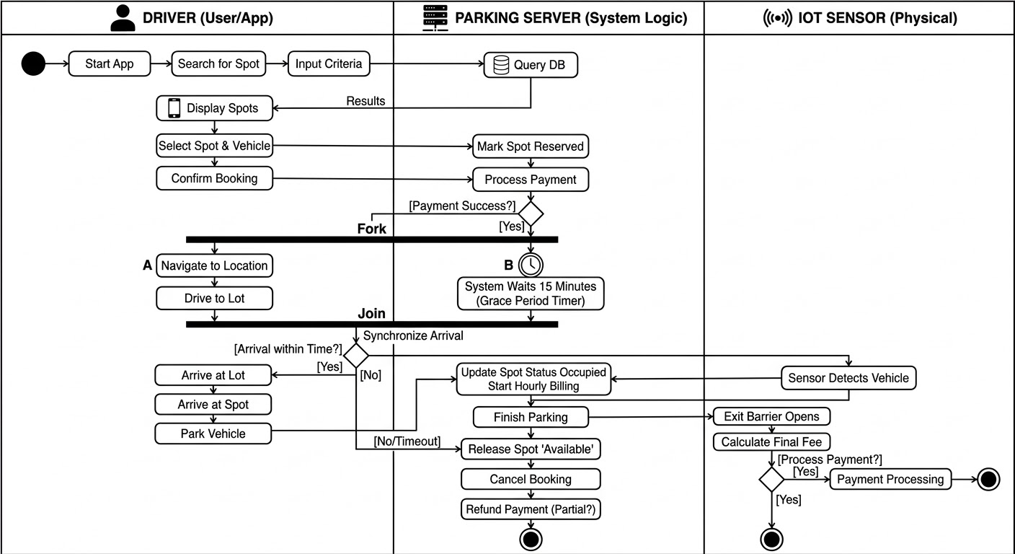

Slide 20
Use Case Model for Smart Parking
Actors
Driver, Parking Admin, System
Main Use Cases
Driver:
Search parking, Reserve parking space, Make payment, Receive notifications
Admin:
Manage parking spaces, Monitor parking usage, Generate reports
Use case diagrams help visualize how users interact with the system.
Notes:
Use case diagrams help visualize how users interact with the system.

Slide 21
Phase 4: Negotiation
Sometimes stakeholder requirements conflict with each other.
Negotiation resolves these conflicts.
Example Conflict
Drivers want long reservation times.
Parking authority fears spaces will remain unused.
Solution
Introduce limited reservation duration (e.g., 10 minutes).
This ensures fairness and efficient space usage.
Notes:
State Machine Diagrams. model the lifecycle of a parking spot to explicitly agree on the rules.
define states: Available →Reserved.
If the sensor doesn't detect a car in 15 minutes, it transitions back to Available (the negotiated rule).

Slide 22
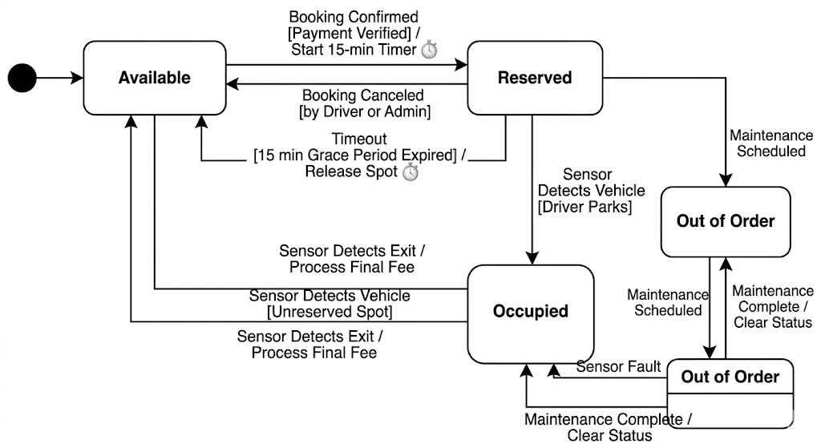

Slide 23
Phase 5: Requirements Specification
Specification documents requirements in a Software Requirement Specification (SRS).
Two main types:
Functional Requirements: Describe system behavior.
System shall display available parking spots.
System shall allow drivers to reserve a slot.
System shall process online payments
Notes:
Sequence Diagrams.
map out the exact message passing over time.

Slide 24
Non-Functional Requirements
Performance Parking updates should occur within 3 seconds.
Security Payment transactions must be encrypted.
Usability Users should locate parking within 3 clicks.

Slide 25
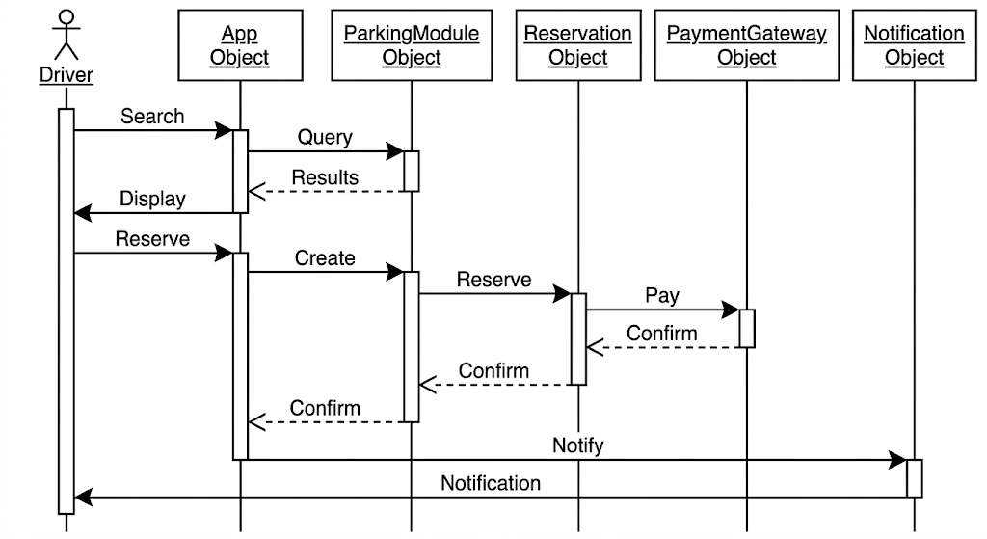
Notes:
For example: Mobile App requests reservation → Parking Server locks the spot in the database →Server sends a success payload back to the App.

Slide 26
Phase 6: Requirements Validation
Validation ensures requirements are:
Correct, Complete, Consistent, Feasible
Validation Techniques
Requirement reviews
Prototyping
Stakeholder meetings
Test case development
Example:
A prototype parking mobile app interface is shown to drivers for feedback.

Slide 27
Phase 7: Requirements Management
Requirements change during development.
Management ensures changes are tracked and controlled.
Activities include:
Change request management
Requirement version control
Traceability tracking
Example Change
City authorities request EV charging parking spots to be integrated into the system.
Notes:
EV chargers

Slide 28
Requirement Traceability Example
Traceability connects requirements with design and testing.
Example
Requirement: Driver can reserve parking slot
Linked to
Use Case: Reserve Parking
Module: Reservation System
Test Case: Parking Reservation Test
Traceability ensures every requirement is implemented and tested.

Slide 29
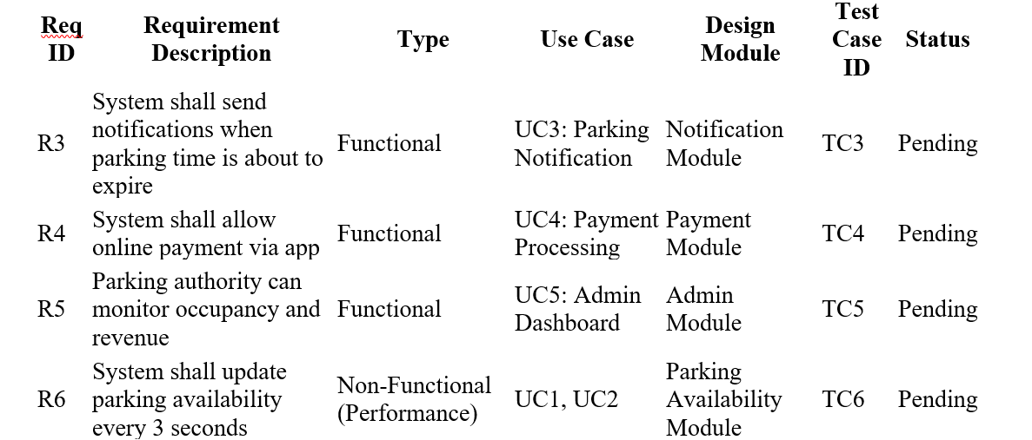
Traceability matrix (Smart Parking System)
Notes:
Req ID: Unique identifier for each requirement.
Requirement Description: Clearly describes what the system must do.
Type: Functional or Non-Functional requirement.
Use Case: Links requirement to one or more UML use cases.
Design Module: The system component or module implementing this requirement.
Test Case ID: Corresponding test case to verify the requirement.
Status: Can be Pending, Implemented, Verified, or Updated.

Slide 30
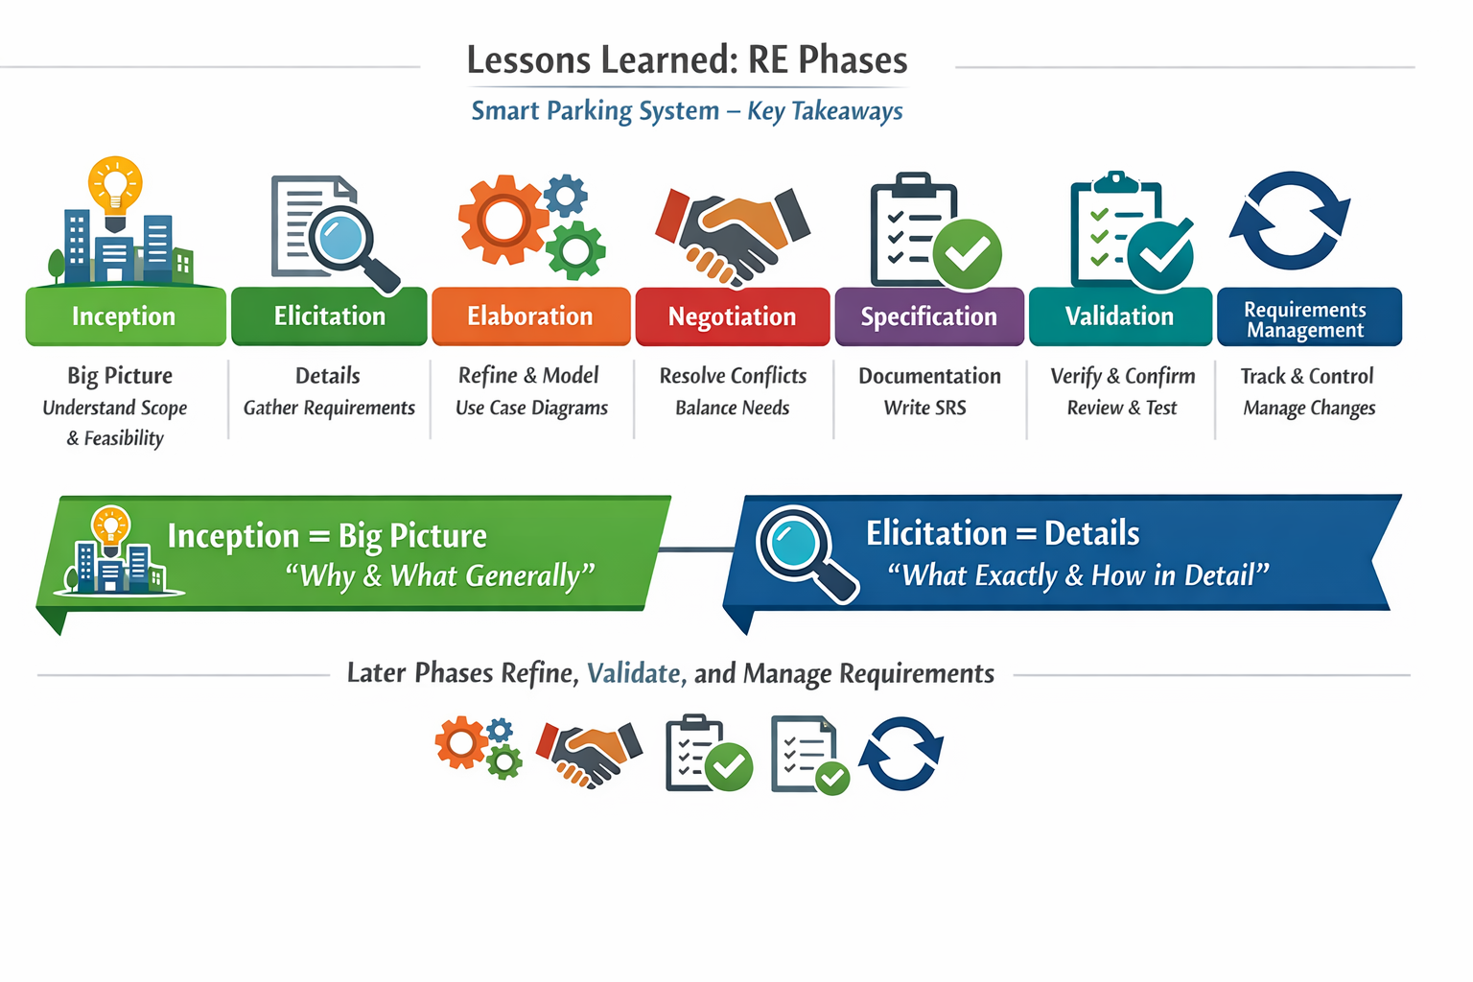
Notes:
Summarize key insights: these phases determine project success or failure. Emphasize the importance of teamwork and documentation.

Slide 31
Mini Project / Class Activity
Choose a simple system:
Identify stakeholders & define inception summary
Apply one elicitation technique (interview/questionnaire)
Document findings
Notes:
This assignment reinforces lecture learning with hands-on practice. Encourage creativity and practical stakeholder engagement.

